Slide 1
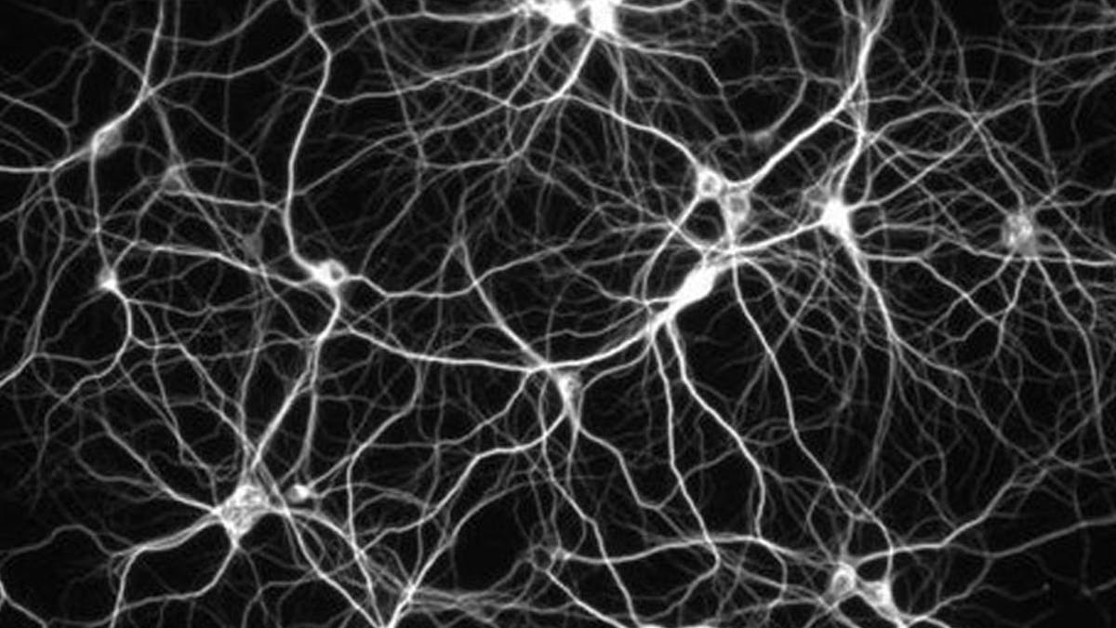
Artificial Neural Networks

